Slide 1

The presidential effect
Chris Bryant, Lauren Tayara,
Raniah Jeanlys, Surafel Gebreyesus
Notes:
Lauren

Slide 2
Agenda
Research
Data
conclusion
Notes:
Lauren

Slide 3
research
Notes:
Lauren

Slide 4
Research Questions
What economic effect (stock market, GDP, unemployment, trade deficit) occurred during each president?
Are the economic indicators dependent or independent of the president?
Does the political party of the president influence the economy?
Does the length of presidency influence the length of economy?
How will past economic results help forecast for future elections?
Motivation: Current election, voter education
Notes:
Lauren

Slide 5


Economic Health Indicators
Data from 1981 - Current
Federal Reserve Economic Data (FRED)
Real Gross Domestic Product (GDP)
Unemployment
Macrotrends.net
Balance of Trade
Dow Jones Stock
Notes:
Lauren

Slide 6
Data
Notes:
Chris

Slide 7
Cleanup
Balance of Trade
Set year as index
Removed
$
B
Dropped % of GDP column
Integer rounded to the nearest whole number
Unemployment
Set date as index
Real GDP
Set date as index
Renamed column
Dow Jones Stock
Set year as index
6 columns dropped
Sorted by year
Notes:
Chris - Jupyter notebook showing code for cleanup

Slide 8
Slicing
All datasets were sliced according to the presidency ranges
Ronald Reagan 1981 - 1988
George Bush 1989 - 1992
Bill Clinton 1993 - 2000
George W. Bush 2001 - 2008
Barak Obama 2009 - 2016
Donald Trump 2017 - Current
Unemployment was adjusted using a 12-month step to indicate full years rather than monthly data.
GDP data was adjusted from quarterly using four steps
Notes:
Chris

Slide 9
ALTAIR
Altair is a Python library designed for statistical visualization. It is declarative in nature (we shall come to this definition later on). It is based on Vega and Vega-Lite, which are both visualization grammar that allows you to describe the visual appearance and interactive behavior of a visualization in a JSON format.
from vega_datasets import data
pip install altair vega_datasets
conda install -c conda-forge altair vega_datasets
import altair as alt
Notes:
Surafel (what it does and importing)

Slide 10
Dashboard
Added to a notebook
Four indicators per president per tab
Click on each president tab and the line plot lights up during each corresponding presidency
The first tab shows the full range from 1981 to current
Notes:
Chris (how we used altair) – explain/show dashboard

Slide 11
Conclusion

Slide 12
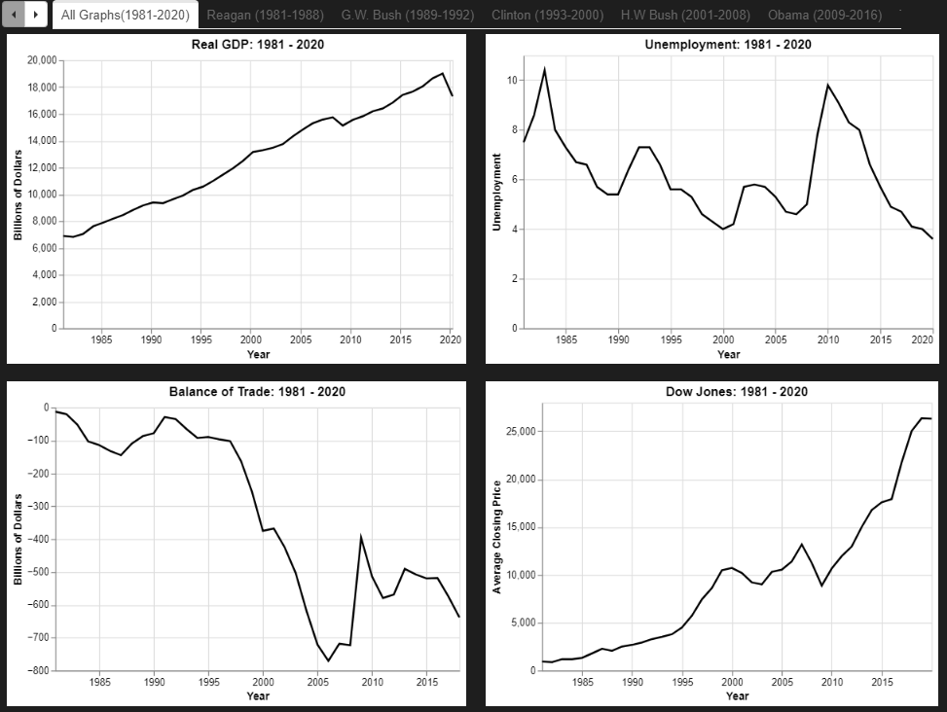
Findings
What effect did each president have on the economy?
The trade deficit and unemployment were successful during Regan and Obama’s presidencies, whereas, they were both not successful during Bush Jr.’s presidency. The trade deficit was not successful during Clinton and Trump’s presidencies but successful on unemployment.
Notes:
Raniah

Slide 13
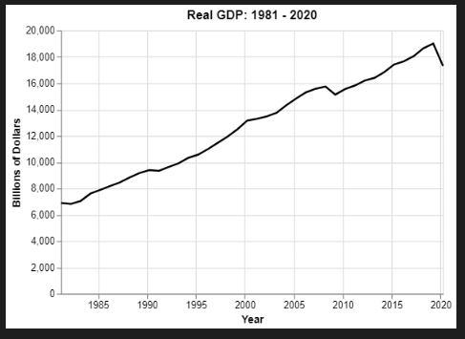
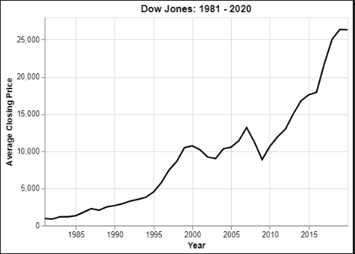
Findings
Are the economic indicators dependent or independent of the president?
Our data showed that for Real GDP and Dow Jones Stock the president was independent of economic performance. For unemployment and Balance of trade, economy is dependent of the presidency.
Notes:
Surafel

Slide 14
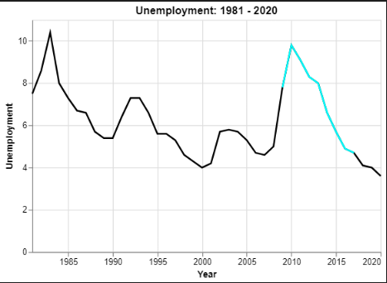
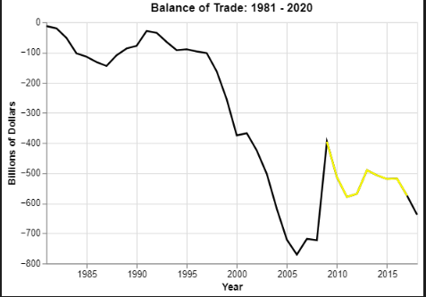
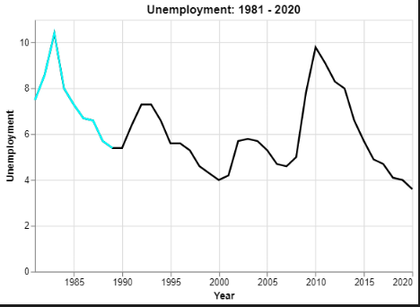
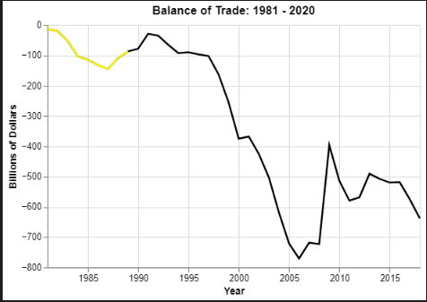
Findings
Obama
Obama
Does the political party of the president influence the economy?
Political party does not predict success of trade or unemployment. For instance, the two most economically successful presidents in trade and unemployment were Reagan and Obama, from two different political parties.
Reagan
Reagan
Notes:
Lauren

Slide 15
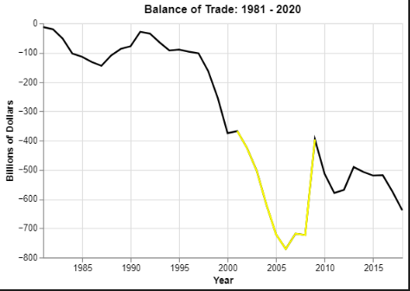
Findings
Bush Jr.
Does the length of presidency influence the length of economic influence?
The data showed improvements from the first to second term in all unemployment for all of the 2-term presidencies except Bush Jr. Balance of trade improved in the second term for the Republican presidents (Reagan and Bush Jr.) but got worse for Democrat presidents (Clinton and Obama).
Notes:
Lauren

Slide 16
Implications
What do the findings mean?
Neither the president nor political party necessarily influence the economy. Two-term presidencies show more opportunity for economic success in unemployment than one term.
How do they impact finance?
According to the indicators analyzed in this research, these results show that the president has little to no influence on finance and the economy. Therefore, promises of economic success made during presidential campaigns do not show throughout the different presidencies. Economic success traditionally associated with certain political parties also does not show valid from this research.
Notes:
Raniah

Slide 17
Implications
How will past economic results help forecast future elections?
Despite people’s personal biases to one president or political party, the research does not show an easy forecast for future elections.
Other Factors
We believe there are other factors that are not covered in our research such as National Security, Health Care, Education and Energy, just to name a few, that should also be counted as indicators.
Policies and regulations by each president
“The hangover effect” - results after a president’s term
Uncontrollable big events - COVID, 9/11, Recession, etc.
Notes:
Raniah

Slide 18
Questions?
Notes:
Surafel – ask but we can all jump in to answer

